Slide 1
BUSINESS CASE
IMPLEMENTATION OF
MICROSOFT DYNAMICS NAVISION

Slide 2
Problem Statement
Currently we have disparate systems used by various departments & business units of ISKCON Bangalore & the associated trusts, which is resulting in a) audit and control issues, b) redundant data entry, c) repeated reconciliation, d) loss of data integrity, e) data availability issues
This has potential impact on meeting the a) statutory compliances, b) timely decision making, c) stakeholder satisfaction and d) man-power requirement.
Out of 61 processes, around 19 are handled manually in TSF-Gifts. In TSF-Foods out of 55 processes, 22 are manual.

Slide 3
Current Scenario
 | ISKCON | TSF GIFT | TSF FOOD | GST
Accounts & Finance | Tally | Tally | Tally | Tally
Fixed Asset Management | Manual | Manual | Manual | Manual
Procurement Planning | NA | Destiny ERP | Manual | Manual
Purchase to Payment | Tally | Destiny ERP | PRISM Futura | Tally
Inventory & Stores | Tally | Destiny ERP | PRISM Futura | Tally
Sales Forecasting | NA | Manual | Manual | Manual
Sales Management | NA | Destiny ERP | Manual | Tally
Production Planning | Manual | Destiny ERP | Manual | NA
Quality Control | Manual | Manual | Manual | Manual
Donations Management | Dhananjaya | NA | NA | NA
Guest House | Guest House | NA | NA | NA
Other incomes (Ticket, Rental) | Manual | NA | NA | NA
Payroll Management | Pay Genie ( procured from TenXLabs)

Slide 4
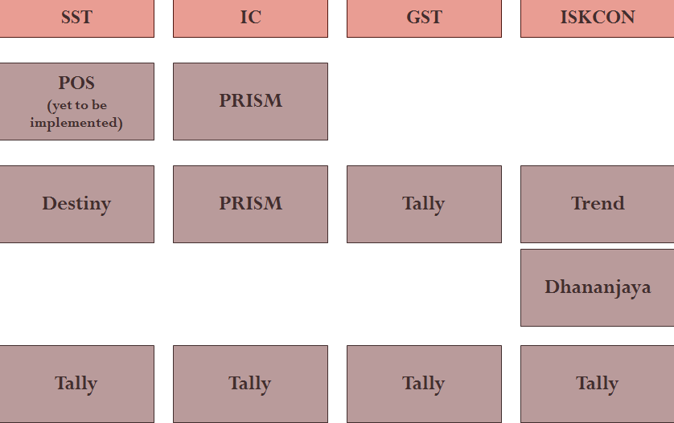
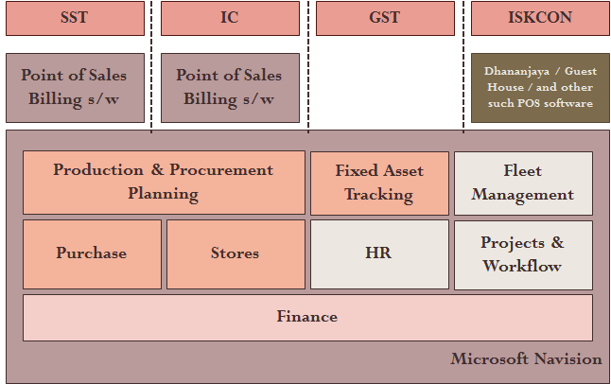
Solution
To implement an ERP which integrates all the departments and business units of ISKCON and the affiliated trusts.
Integrate Donation Management System and Point of Sales applications with ERP.
Current Island Systems
Proposed Integrated System

Slide 5
Project Objectives
ERP Implementation for ISKCON, TSF (Gifts and Foods), GST covering the following modules:
Accounts & Finance
Procurement to Payment
Inventory & Stores
Quality Control
Production Planning
Sales Forecasting & Sales Management
Fixed Assets Register
Job Management (Projects)
Dhananjaya (Donor Management System) Integration

Slide 6
Business Value - Strategic
Enables management to make quicker & better decisions by ensuring timely availability of accurate data.
Enables organization to improve customer experience by taking further specific projects.
Improved opportunities for cross-selling.

Slide 7
Business Value - Customer
Enables accounts to do purpose-based accounting of the donation income received which will in turn bring in more transparency, there by improving the good-will.
We can provide report on Donation Utilization to our Donors.
We can design our donation schemes based on the purpose.

Slide 8
Business Value - Operational
Enables accounts to implement better accounting practices according to industry standards.
Information System Audit conducted on the disparate systems have identified 81 control issues out of which ____ can be addressed and resolved by implementing an integrated software system like ERP.
Implementation of ERP will also help us in Improved Budgetary Control, Improved Warning System and Improved Regulatory Compliances. A study by [] shows that the cost of non-compliance and lack of control can be up to 5% of the total revenue of the organization, which amounts to []

Slide 9
Business Case - Operational
Reduction in bad debts owing to lack of internal control : In 2014-2015 we have written off Rs. 11.5 Lakhs in food division of TSF & GST and Rs. 4 Lakhs in Gift Division of which 30% is due to wrong accounting and 40% due to billing even after exceeding credit limit as per policy. Such instances (which caters to 70% of the bad debts) can be totally avoided if we have the required controls which ERP provides.
Reduction in cheque clearance time: The delays in manual cheque processing procedure at Dhananjaya & Finance department can be eliminated by integrating Dhananjaya with ERP. The cycle time can be reduced by 1 day.

Slide 10
Business Value - Operational
Elimination of Redundant Data Entry Effort: Currently accounts team spend more than 1784 hours in reentering the data from various entities. This redundant effort can be completely eliminated.
Reduction in Reconciliation Effort: The accounts team spends more than 40 hours a month reconciling the inter trust balances which can be avoided by implementation of ERP.

Slide 11
Redundant Data Entry Effort
Type of Transaction | Transactions / Year | Approximate Effort
Donation Receipts | 14400 | 480 hrs
Bank Clearance Updates | 27240 | 113 hrs
Donation data Reconciliation | 14400 | 24 hrs
Purchase data from TSF Food | 4836 | 242 hrs
Sales data from TSF Food | 5360 | 179 hrs
Purchase data from TSF Gifts | 2668 | 133 hrs
Sales data from TSF Gifts | 2606 | 87 hrs
Purchase data from GST | 487 | 24 hrs
Sales data from GST | 40 | 1 hrs
Purchase data from ISKCON | 5058 | 253 hrs
Purchase data from Krishnamrita | 1680 | 84 hrs
Guest House data | 4896 | 163 hrs

Slide 12
Reduction in Cycle Time
Process Name | Current Cycle | After Automation
Sales Forecast & Planning | 3 days | 2 hours
Purchase Planning | 10 days | 1 day
Purchase Order Processing | 8 days | 3 days
Purchase Inward Notes | 15 days | 2 days
Goods Receipts / QC Inspection | 12 days | 3 days
Indent Processing | 15 days | 4 days

Slide 13
Reduction in Processing Effort
Currently the team handling TSF Food division spends lot of time processing the data, which can be considerably reduced by having an integrated system which minimizes the data entry / consolidation / reconciliation effort. The post automation effort specified is only an approximate estimation.
Process Name | Effort / Month | Post Automation
Production | 3 days | 2 hours
Purchase | 15 days | 5 days
Stores | 12 days | 4 days
Sales | 4 days | 2 days
Debit Notes | 5 days | No effort

